Slide 1


Calculus and applications
MTH10012
Week 2

Slide 2
Introduction
MODULE 1
Week 1
Sets of numbers, set operations, induction principle
Functions and their properties, composition and inverse function
Week 2
Elementary functions and their graphs
  Dirichlet, absolute value, sign and Heaviside, integer and fractional part, linear, power (odd and even), polynomial, rational, algebraic, exponential and logarithmic, trigonometric, inverse trigonometric, hyperbolic and inverse hyperbolic
MODULE 2
Limit of a function, one-sided limits
Limit laws

Slide 3
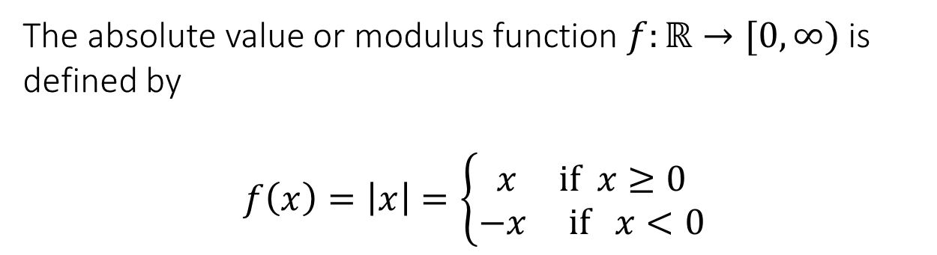

1.5 Elementary Functions
Dirichlet function
The Dirichlet function $D:ℝ→\{0,1\}$ is given by
$$D\left(x\right)=\left\{\begin{matrix}0 if xεℚ \\ 1 if xεI\end{matrix}\right.$$
Absolute value function
The absolute value or modulus function $f:ℝ→[0,∞)$ is defined by
$$f\left(x\right)=\left|x\right|=\left\{\begin{matrix}x if x≥0 \\ −x if x<0\end{matrix}\right.$$

Slide 4
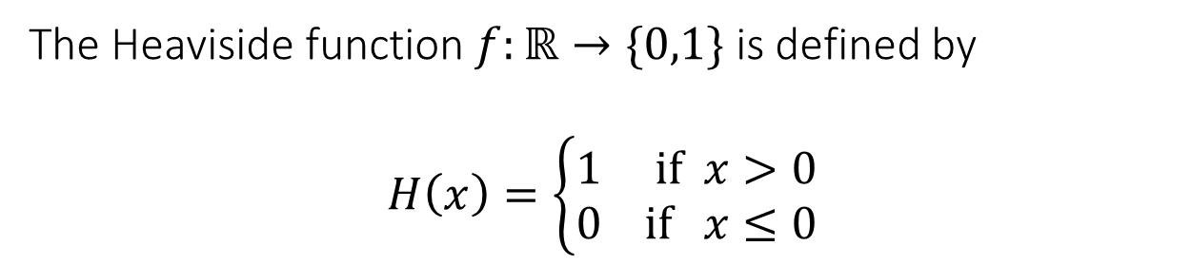
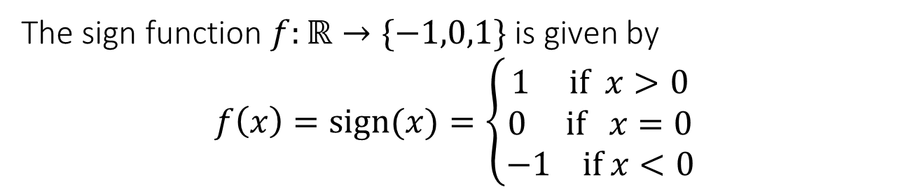
1.5 Elementary Functions
Sign function
The sign function $f:ℝ→\{−1,0,1\}$ is given by
$$f\left(x\right)=sign(x)=\left\{\begin{matrix}1 if x>0 \\ 0 if x=0 \\ −1 if x<0\end{matrix}\right.$$
Heaviside function
The Heaviside function $f:ℝ→\{0,1\}$ is defined by
$$H\left(x\right)=\left\{\begin{matrix}1 if x>0 \\ 0 if x≤0\end{matrix}\right.$$

Slide 5
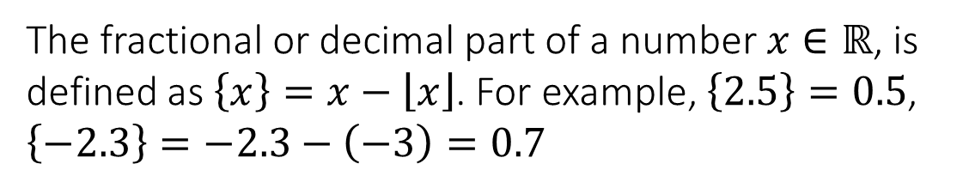
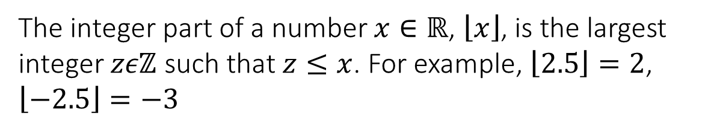
1.5 Elementary Functions
Integer part (or “floor”) function
The integer part of a number $x∈ℝ$, $\left\lfloor x\right\rfloor$, is the largest integer $zεℤ$ such that $z≤x$. For example, $\left\lfloor 2.5\right\rfloor =2$, $\left\lfloor −2.5\right\rfloor =−3$
Fractional part function
The fractional or decimal part of a number $x∈ℝ$, is defined as $\left\{x\right\}=x−\left\lfloor x\right\rfloor$. For example, $\left\{2.5\right\}=0.5$, $\left\{−2.3\right\}=−2.3−\left(−3\right)=0.7$

Slide 6
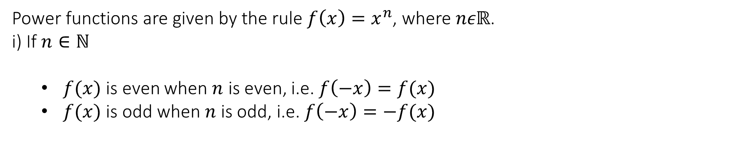
1.5 Elementary Functions
Linear functions
Linear functions have the form $y=f\left(x\right)=mx+b$, where $m=\frac{y_{2}−y_{1}}{x_{2}−x_{1}}$ is the gradient (or slope), $b$ is the y-intercept, and $P_{1}\left(x_{1,}y_{1}\right), P_{2}\left(x_{2},y_{2}\right)$ are any two points on the graph of $f$.
Power functions
Power functions are given by the rule $f\left(x\right)=x^{n}$, where $nεℝ$.
i) If $n∈ℕ$
  $f(x)$ is even when $n$ is even, i.e. $f\left(−x\right)=f(x)$
  $f(x)$ is odd when $n$ is odd, i.e. $f\left(−x\right)=−f(x)$

Slide 7
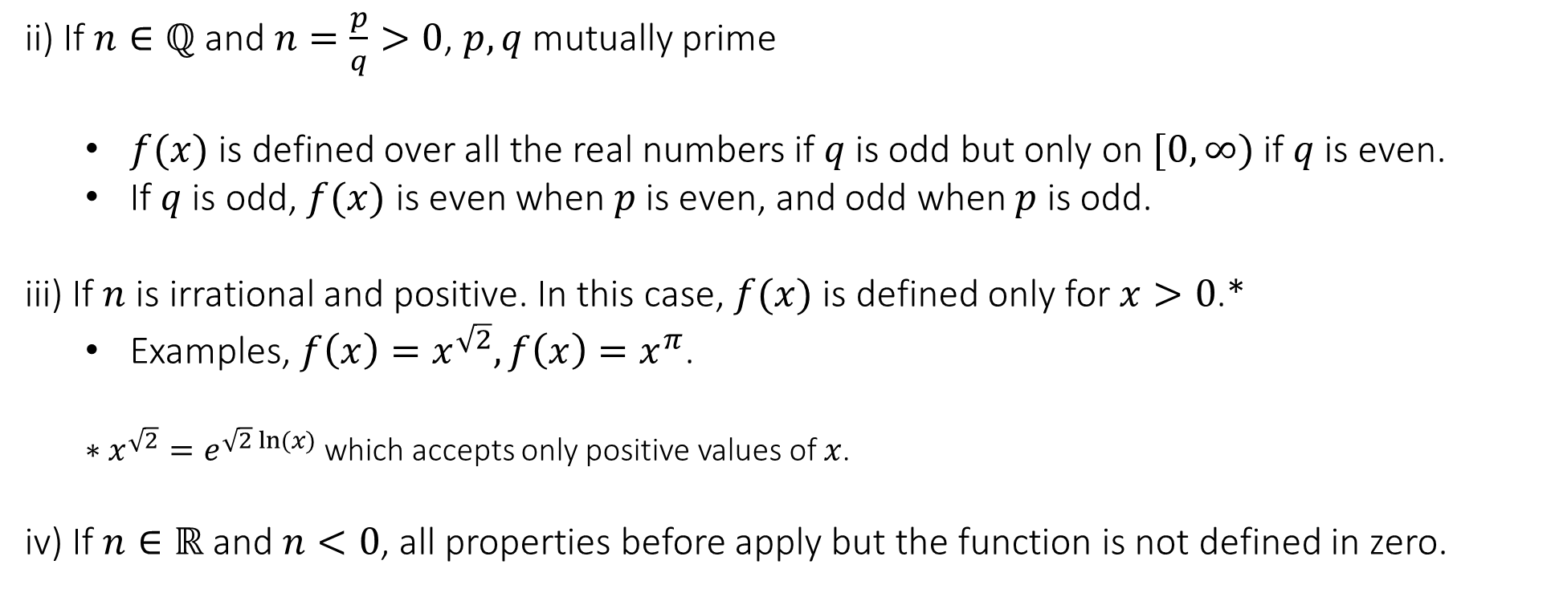
1.5 Elementary Functions
Power functions
ii) If $n∈ℚ$ and $n=\frac{p}{q}>0$, $p,q$ mutually prime
  $f(x)$ is defined over all the real numbers if $q$ is odd but only on $[0,∞)$ if $q$ is even.
  If $q$ is odd, $f(x)$ is even when $p$ is even, and odd when $p$ is odd.
  iii) If $n$ is irrational and positive. In this case, $f(x)$ is defined only for $x>0$.*
    Examples, $f\left(x\right)=x^{\sqrt{2}}, f\left(x\right)=x^{π}$.
    $∗x^{\sqrt{2}}=e^{\sqrt{2} ln⁡(x)}$ which accepts only positive values of $x$.
    iv) If $n∈ℝ$ and $n<0$, all properties before apply but the function is not defined in zero.

Slide 8
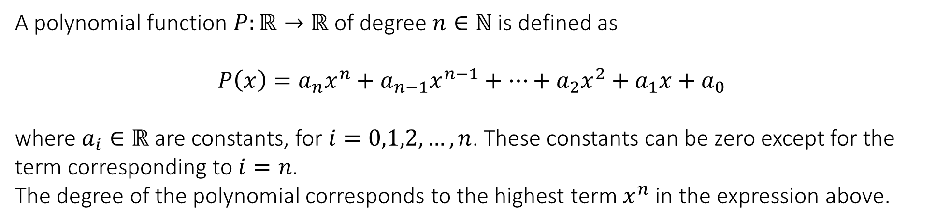
1.5 Elementary functions
Polynomial functions
A polynomial function $P:ℝ→ℝ$ of degree $n∈ℕ$ is defined as
$$P\left(x\right)=a_{n}x^{n}+a_{n−1}x^{n−1}+…+a_{2}x^{2}+a_{1}x+a_{0}$$
where $a_{i}∈ℝ$ are constants, for $i=0,1,2,…,n$. These constants can be zero except for the term corresponding to $i=n$.
The degree of the polynomial corresponds to the highest term $x^{n}$ in the expression above.

Slide 9
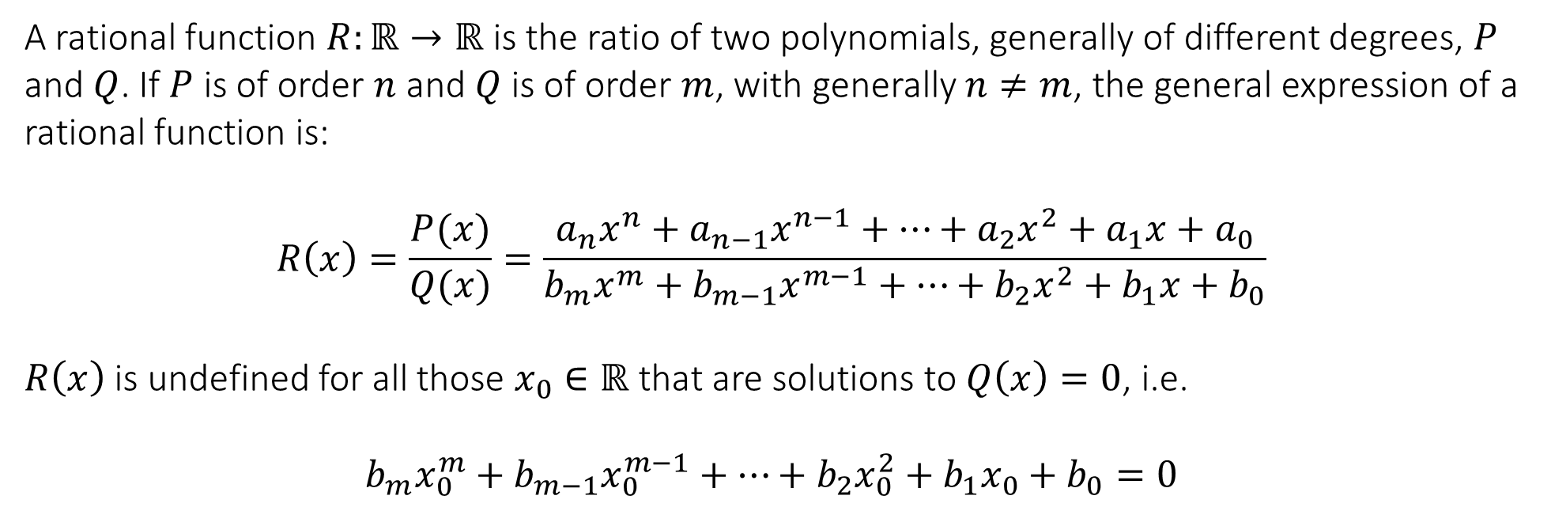
1.5 Elementary functions
Rational functions
A rational function $R:ℝ→ℝ$ is the ratio of two polynomials, generally of different degrees, $P$ and $Q$. If $P$ is of order $n$ and $Q$ is of order $m$, with generally $n≠m$, the general expression of a rational function is:
$$R\left(x\right)=\frac{P(x)}{Q(x)}=\frac{a_{n}x^{n}+a_{n−1}x^{n−1}+…+a_{2}x^{2}+a_{1}x+a_{0}}{b_{m}x^{m}+b_{m−1}x^{m−1}+…+b_{2}x^{2}+b_{1}x+b_{0}}$$
$R\left(x\right)$ is undefined for all those $x_{0}∈ℝ$ that are solutions to $Q\left(x\right)=0$, i.e.
$$b_{m}x_{0}^{m}+b_{m−1}x_{0}^{m−1}+…+b_{2}x_{0}^{2}+b_{1}x_{0}+b_{0}=0$$

Slide 10
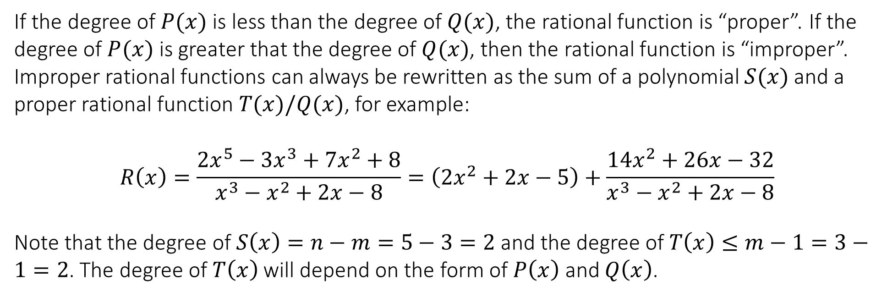
1.5 Elementary functions
Rational functions
If the degree of $P(x)$ is less than the degree of $Q(x)$, the rational function is “proper”. If the degree of $P(x)$ is greater that the degree of $Q(x)$, then the rational function is “improper”.
Improper rational functions can always be rewritten as the sum of a polynomial $S(x)$ and a proper rational function $T(x)/Q(x)$, for example:
$$R\left(x\right)=\frac{2x^{5}−3x^{3}+7x^{2}+8}{x^{3}−x^{2}+2x−8}=\left(2x^{2}+2x−5\right)+\frac{14x^{2}+26x−32}{x^{3}−x^{2}+2x−8}$$
Note that the degree of $S\left(x\right)=n−m=5−3=2$ and the degree of $T\left(x\right)≤m−1=3−1=2$. The degree of $T\left(x\right)$ will depend on the form of $P\left(x\right)$ and $Q\left(x\right)$.

Slide 11
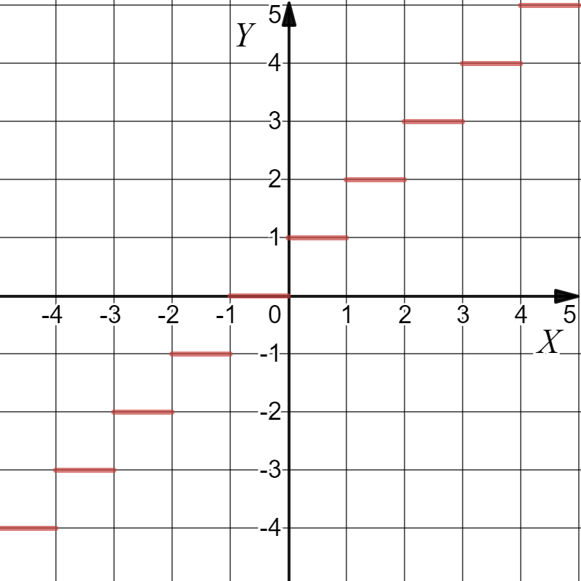

Test your knowledge
1. Which of the following functions is odd?
a. $y=2$ b. $y=x^{1.5}$ c. $y=x^{\frac{3}{5}}$ d. $y=x^{−π}$
2. Which function is represented in the following graph?
a. $f\left(x\right)=x−\left|x\right|$
b. $f\left(x\right)=1+\left\lfloor x\right\rfloor$
c. $f\left(x\right)=\left\lfloor x\right\rfloor −1$

Slide 12
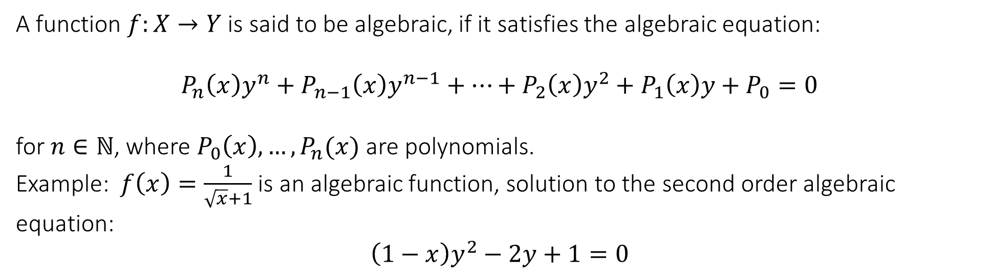
1.5 Elementary functions
Algebraic functions
A function $f:X→Y$ is said to be algebraic, if it satisfies the algebraic equation:
$$P_{n}\left(x\right)y^{n}+P_{n−1}\left(x\right)y^{n−1}+…+P_{2}\left(x\right)y^{2}+P_{1}\left(x\right)y+P_{0}=0$$
for $n∈ℕ$, where $P_{0}\left(x\right),…, P_{n}(x)$ are polynomials.
Example: $f\left(x\right)=\frac{1}{\sqrt{x}+1}$ is an algebraic function, solution to the second order algebraic equation:
$$\left(1−x\right)y^{2}−2y+1=0$$

Slide 13
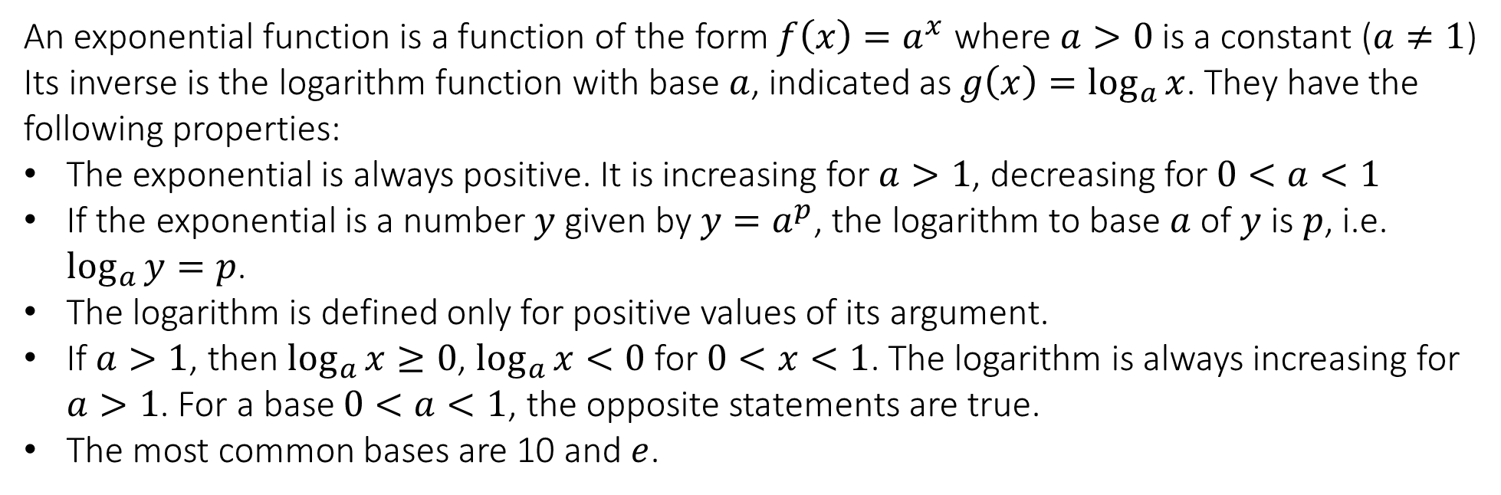
1.5 Elementary functions
Exponential and logarithm functions
An exponential function is a function of the form $f\left(x\right)=a^{x}$ where $a>0$ is a constant ($a≠1$)
Its inverse is the logarithm function with base $a$, indicated as $g\left(x\right)=\log_{a}{x}$. They have the following properties:
The exponential is always positive. It is increasing for $a>1$, decreasing for $0<a<1$
If the exponential is a number $y$ given by $y=a^{p}$, the logarithm to base $a$ of $y$ is $p$, i.e. $\log_{a}{y}=p$.
The logarithm is defined only for positive values of its argument.
If $a>1$, then $\log_{a}{x}≥0$, $\log_{a}{x}<0$ for $0<x<1$. The logarithm is always increasing for $a>1$. For a base $0<a<1$, the opposite statements are true.
The most common bases are 10 and $e$.

Slide 14
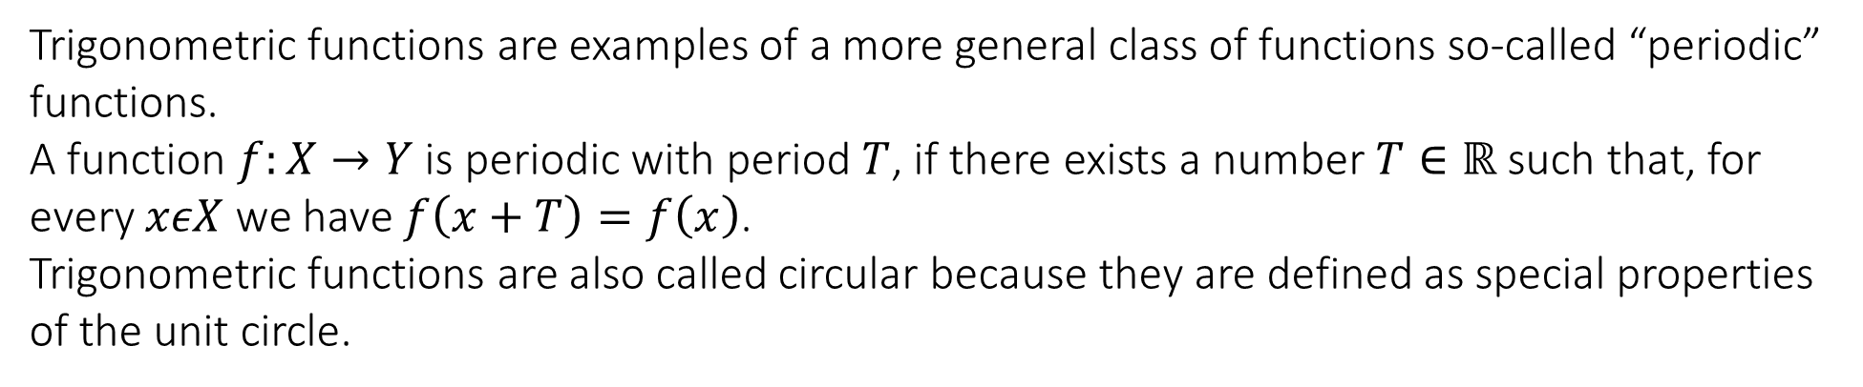
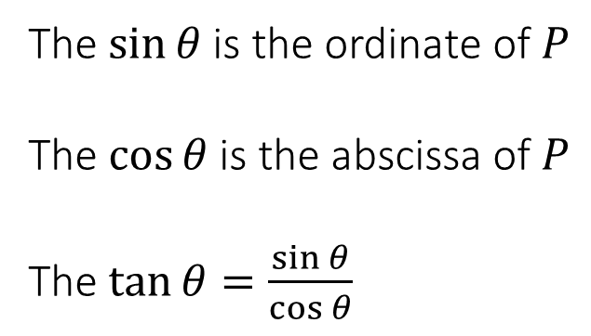
1.5 Elementary functions
Trigonometric or circular functions
Trigonometric functions are examples of a more general class of functions so-called “periodic” functions.
A function $f:X→Y$ is periodic with period $T$, if there exists a number $T∈ℝ$ such that, for every $xεX$ we have $f\left(x+T\right)=f\left(x\right)$.
Trigonometric functions are also called circular because they are defined as special properties of the unit circle.
The $\sin{θ}$ is the ordinate of $P$
The $\cos{θ}$ is the abscissa of $P$
The $\tan{θ}=\frac{\sin{θ}}{\cos{θ}}$

Slide 15
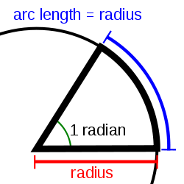
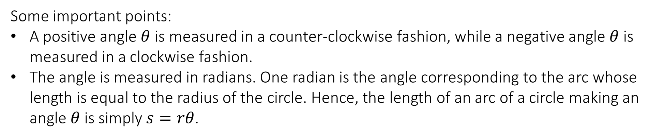
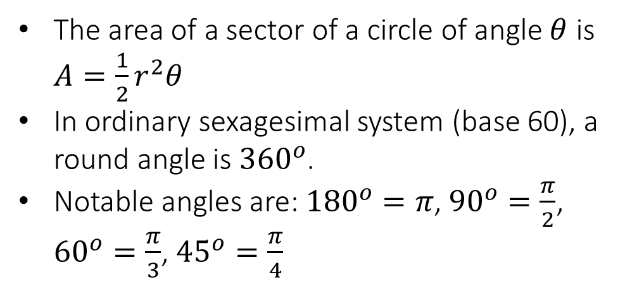
1.5 Elementary functions
Trigonometric or circular functions
Some important points:
A positive angle $θ$ is measured in a counter-clockwise fashion, while a negative angle $θ$ is measured in a clockwise fashion.
The angle is measured in radians. One radian is the angle corresponding to the arc whose length is equal to the radius of the circle. Hence, the length of an arc of a circle making an angle $θ$ is simply $s=rθ$.
The area of a sector of a circle of angle $θ$ is $A=\frac{1}{2}r^{2}θ$
In ordinary sexagesimal system (base 60), a round angle is ${360}^{o}$.
Notable angles are: ${180}^{o}=π$, ${90}^{o}=\frac{π}{2}$, ${60}^{o}=\frac{π}{3}$, ${45}^{o}=\frac{π}{4}$
1

Slide 16
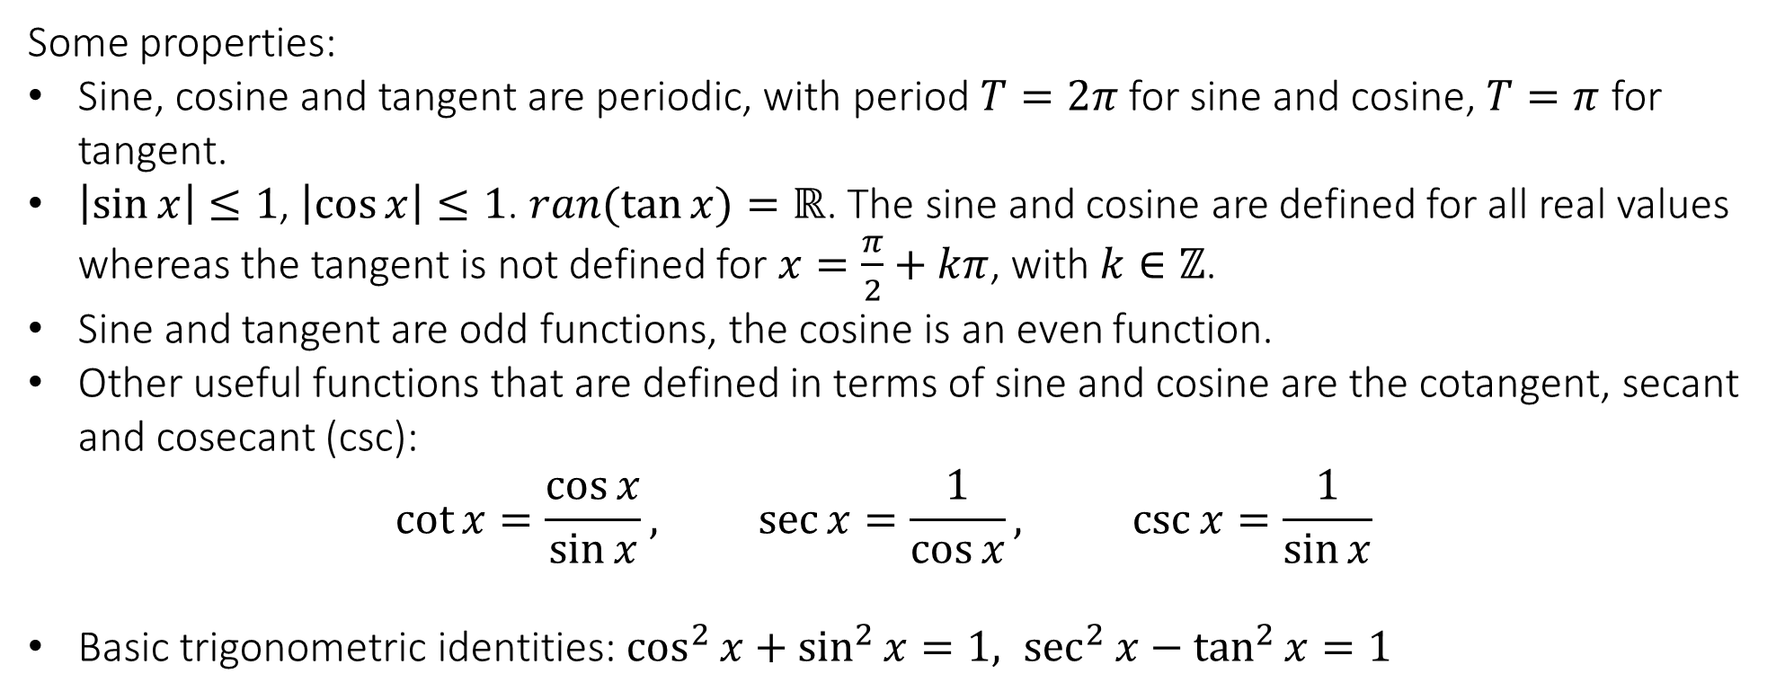
1.5 Elementary functions
Trigonometric or circular functions
Some properties:
Sine, cosine and tangent are periodic, with period $T=2π$ for sine and cosine, $T=π$ for tangent.
$\left|\sin{x}\right|≤1$, $\left|\cos{x}\right|≤1$. $ran(\tan{x)}=ℝ$. The sine and cosine are defined for all real values whereas the tangent is not defined for $x=\frac{π}{2}+kπ$, with $k∈ℤ$.
Sine and tangent are odd functions, the cosine is an even function.
Other useful functions that are defined in terms of sine and cosine are the cotangent, secant and cosecant (csc):
$$\cot{x=\frac{\cos{x}}{\sin{x}}, \sec{x}=\frac{1}{\cos{x}}, \csc{x}=\frac{1}{\sin{x}}}$$
Basic trigonometric identities: $\cos^{2}{x}+\sin^{2}{x}=1, \sec^{2}{x}−\tan^{2}{x}=1$
https://www.geogebra.org/m/Cb2jWUPS

Slide 17
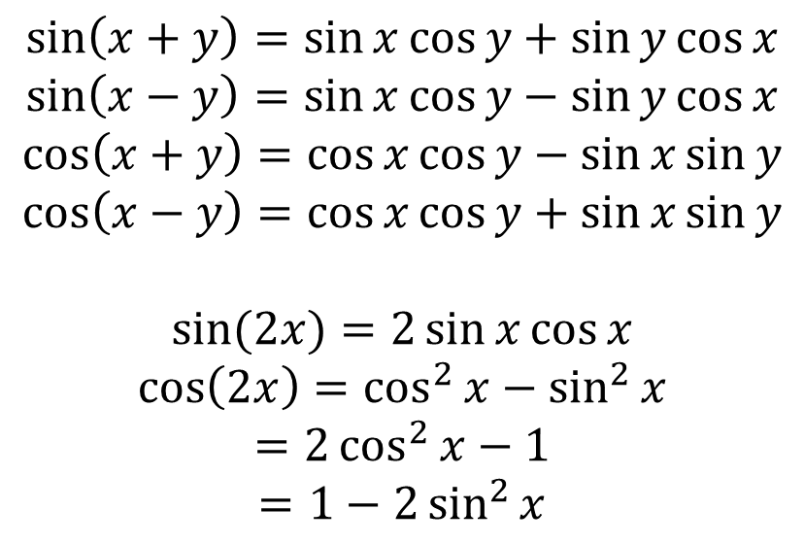
1.5 Elementary functions
Trigonometric or circular functions
Important formulae:
$$\sin\left(x+y\right)=\sin{x}\cos{y}+\sin{y}\cos{x}$$
$$\sin\left(x−y\right)=\sin{x}\cos{y}−\sin{y}\cos{x}$$
$$\cos\left(x+y\right)=\cos{x}\cos{y}−\sin{x}\sin{y}$$
$$\cos\left(x−y\right)=\cos{x}\cos{y}+\sin{x}\sin{y}$$
$$\sin{(2x)}=2\sin{x}\cos{x}$$
$$\cos\left(2x\right)=\cos^{2}{x}−\sin^{2}{x}$$
$$=2\cos^{2}{x}−1$$
$$=1−2\sin^{2}{x}$$

Slide 18

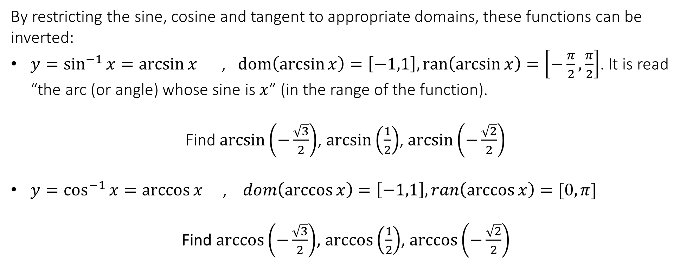

1.5 Elementary functions
Inverse Trigonometric functions
By restricting the sine, cosine and tangent to appropriate domains, these functions can be inverted:
$y=\sin^{−1}{x}=\arcsin{x}$ , $dom\left(\arcsin{x}\right)=\left[−1,1\right], ran\left(\arcsin{x}\right)=\left[−\frac{π}{2},\frac{π}{2}\right]$. It is read “the arc (or angle) whose sine is $x$” (in the range of the function).
Find $\arcsin\left(−\frac{\sqrt{3}}{2}\right)$, $\arcsin\left(\frac{1}{2}\right)$, $\arcsin\left(−\frac{\sqrt{2}}{2}\right)$
$y=\cos^{−1}{x}=\arccos{x}$ , $dom\left(\arccos{x}\right)=\left[−1,1\right], ran\left(\arccos{x}\right)=[0,π]$
Find $\arccos\left(−\frac{\sqrt{3}}{2}\right)$, $\arccos\left(\frac{1}{2}\right)$, $\arccos\left(−\frac{\sqrt{2}}{2}\right)$
$$−\frac{π}{3},\frac{π}{6},−\frac{π}{4}$$
$$\frac{5π}{6},\frac{π}{3}, \frac{3π}{4}$$
https://www.geogebra.org/m/RvXAnYR5

Slide 19

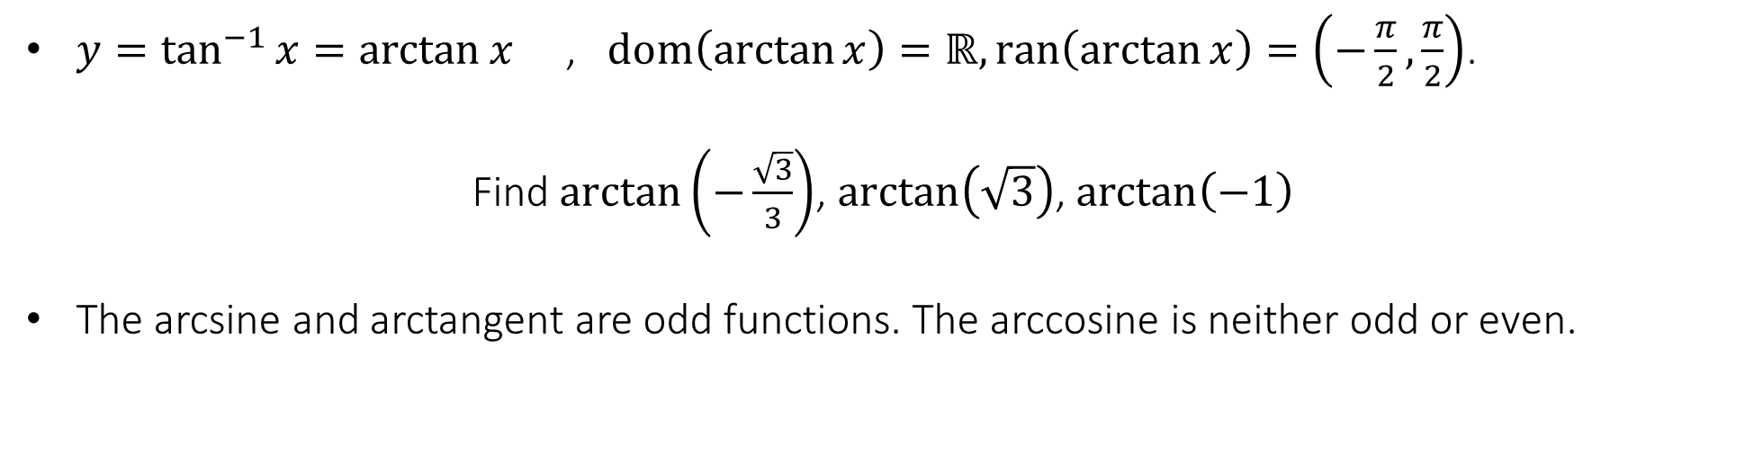
1.5 Elementary functions
Inverse Trigonometric functions
$y=\tan^{−1}{x}=\arctan{x}$ , $dom\left(\arctan{x}\right)=ℝ, ran\left(\arctan{x}\right)=\left(−\frac{π}{2},\frac{π}{2}\right)$.
Find $\arctan\left(−\frac{\sqrt{3}}{3}\right)$, $\arctan\left(\sqrt{3}\right)$, $\arctan\left(−1\right)$
The arcsine and arctangent are odd functions. The arccosine is neither odd or even.
$$−\frac{π}{6},\frac{π}{3},−\frac{π}{4}$$

Slide 20
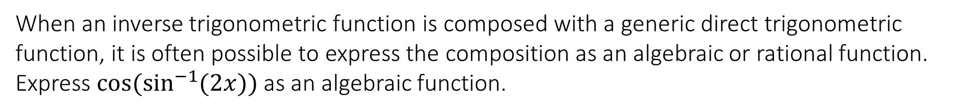
1.5 Elementary functions
Inverse Trigonometric functions
When an inverse trigonometric function is composed with a generic direct trigonometric function, it is often possible to express the composition as an algebraic or rational function.
Express $\cos{(\sin^{−1}{(2x))}}$ as an algebraic function.

Slide 21
1.5 Elementary functions
Inverse Trigonometric functions
Express $\cos{(2\tan^{−1}{(3x))}}$ as a rational function.

Slide 22
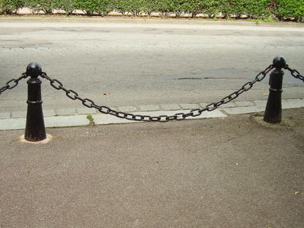
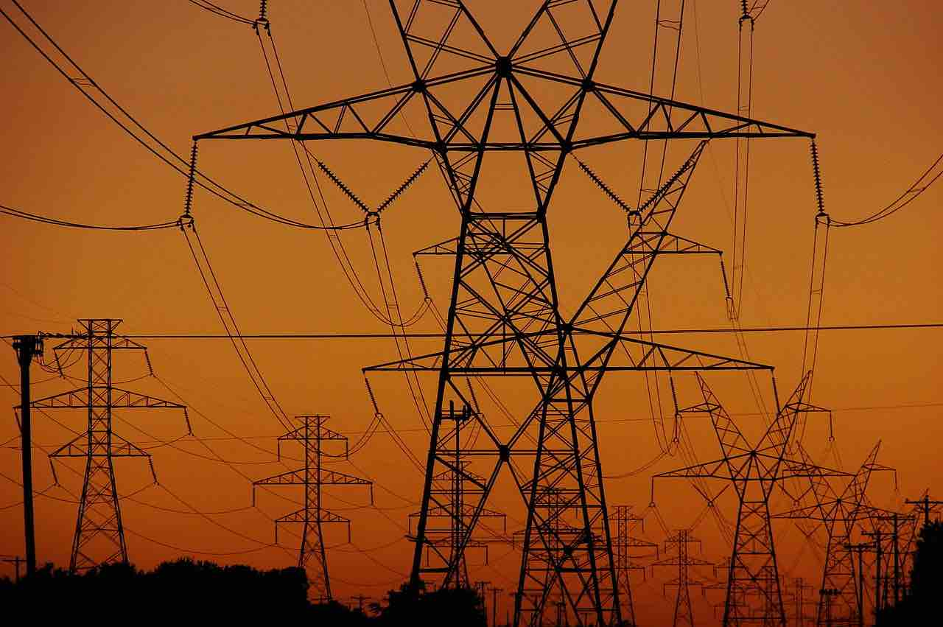

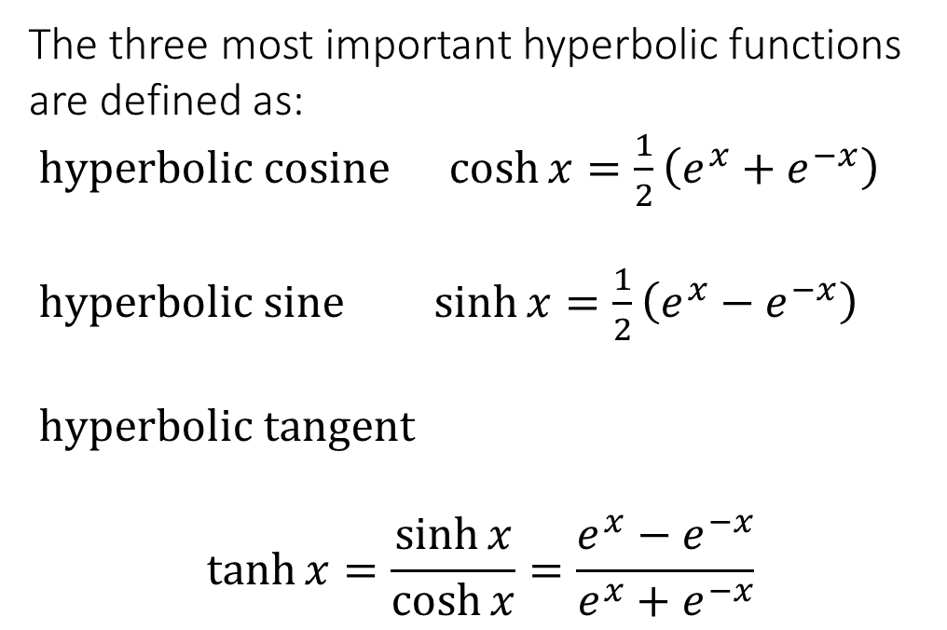
1.5 Elementary functions
Hyperbolic functions
The three most important hyperbolic functions are defined as:
$hyperbolic cosine \cosh{x}=\frac{1}{2}\left(e^{x}+e^{−x}\right)$
$hyperbolic sine \sinh{x}=\frac{1}{2}\left(e^{x}−e^{−x}\right)$
$hyperbolic tangent$
$$\tanh{x}=\frac{\sinh{x}}{\cosh{x}}=\frac{e^{x}−e^{−x}}{e^{x}+e^{−x}}$$

Slide 23
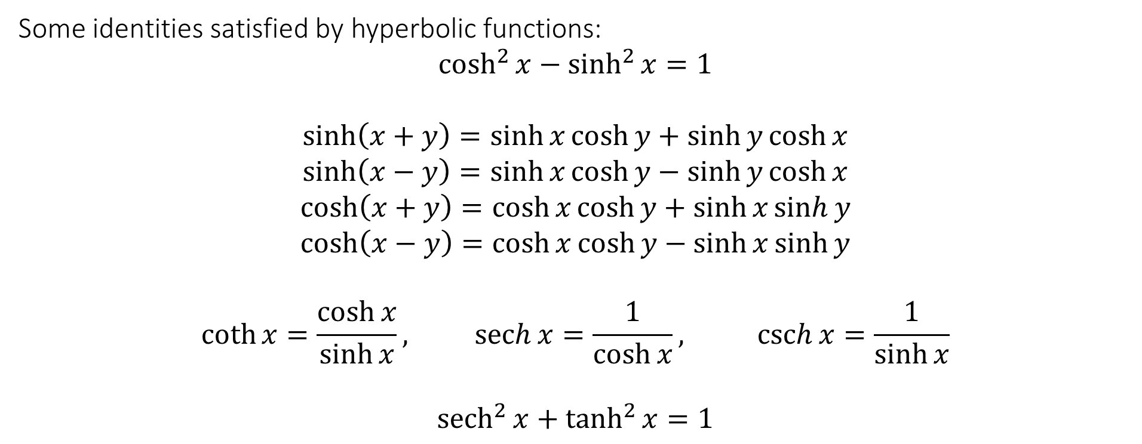
1.5 Elementary functions
Hyperbolic functions
Some identities satisfied by hyperbolic functions:
$$\cosh^{2}{x}−\sinh^{2}{x}=1$$
$$\sinh\left(x+y\right)=\sinh{x}\cosh{y}+\sinh{y}\cosh{x}$$
$$\sinh\left(x−y\right)=\sinh{x}\cosh{y}−\sinh{y}\cosh{x}$$
$$\cosh\left(x+y\right)=\cosh{x}\cosh{y}+\sinh{x}\sinh{y}$$
$$\cosh\left(x−y\right)=\cosh{x}\cosh{y}−\sinh{x}\sinh{y}$$
$$\coth{x=\frac{\cosh{x}}{\sinh{x}}, \operatorname{sech}{x}=\frac{1}{\cosh{x}}, \operatorname{csch}{x}=\frac{1}{\sinh{x}}}$$
$${sech}^{2}{x}+\tanh^{2}{x}=1$$

Slide 24
1.5 Elementary functions
Hyperbolic functions
Prove the fundamental identity of hyperbolic functions: $\cosh^{2}{x}−\sinh^{2}{x}=1$
https://www.geogebra.org/m/D4HRCmnH

Slide 25
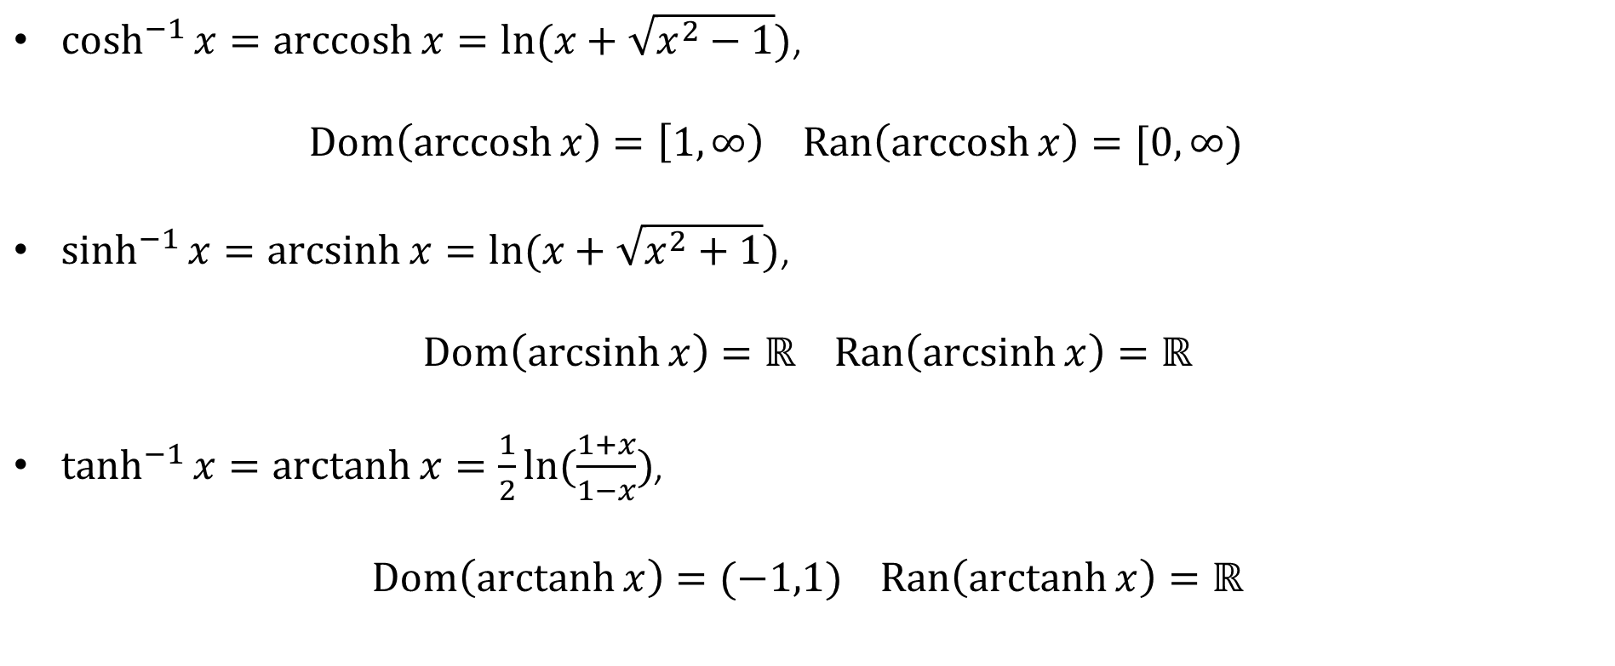
1.5 Elementary functions
Inverse Hyperbolic functions
$\cosh^{−1}{x}=\operatorname{arccosh}{x}=ln⁡(x+\sqrt{x^{2}−1})$,
  $$Dom\left(\operatorname{arccosh}{x}\right)=\left[1,∞\right) Ran\left(\operatorname{arccosh}{x}\right)=[0,∞)$$
$\sinh^{−1}{x}=\operatorname{arcsinh}{x}=ln⁡(x+\sqrt{x^{2}+1})$,
$$Dom\left(\operatorname{arcsinh}{x}\right)=ℝ Ran\left(\operatorname{arcsinh}{x}\right)=ℝ$$
$\tanh^{−1}{x}=\operatorname{arctanh}{x}=\frac{1}{2}ln⁡(\frac{1+x}{1−x})$,
$$Dom\left(\operatorname{arctanh}{x}\right)=(−1,1) Ran\left(\operatorname{arctanh}{x}\right)=ℝ$$

Slide 26
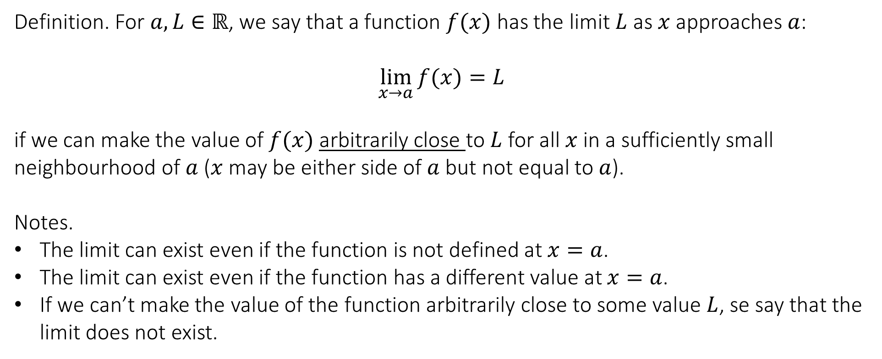
2.1 The concept of limit
MODULE 2
Definition. For $a,L∈ℝ$, we say that a function $f(x)$ has the limit $L$ as $x$ approaches $a$:
$$\lim_{x→a}{f(x)}=L$$
if we can make the value of $f(x)$ arbitrarily close to $L$ for all $x$ in a sufficiently small neighbourhood of $a$ ($x$ may be either side of $a$ but not equal to $a$).
Notes.
The limit can exist even if the function is not defined at $x=a$.
The limit can exist even if the function has a different value at $x=a$.
If we can’t make the value of the function arbitrarily close to some value $L$, se say that the limit does not exist.
https://www.geogebra.org/m/Jf7rP6uK

Slide 27
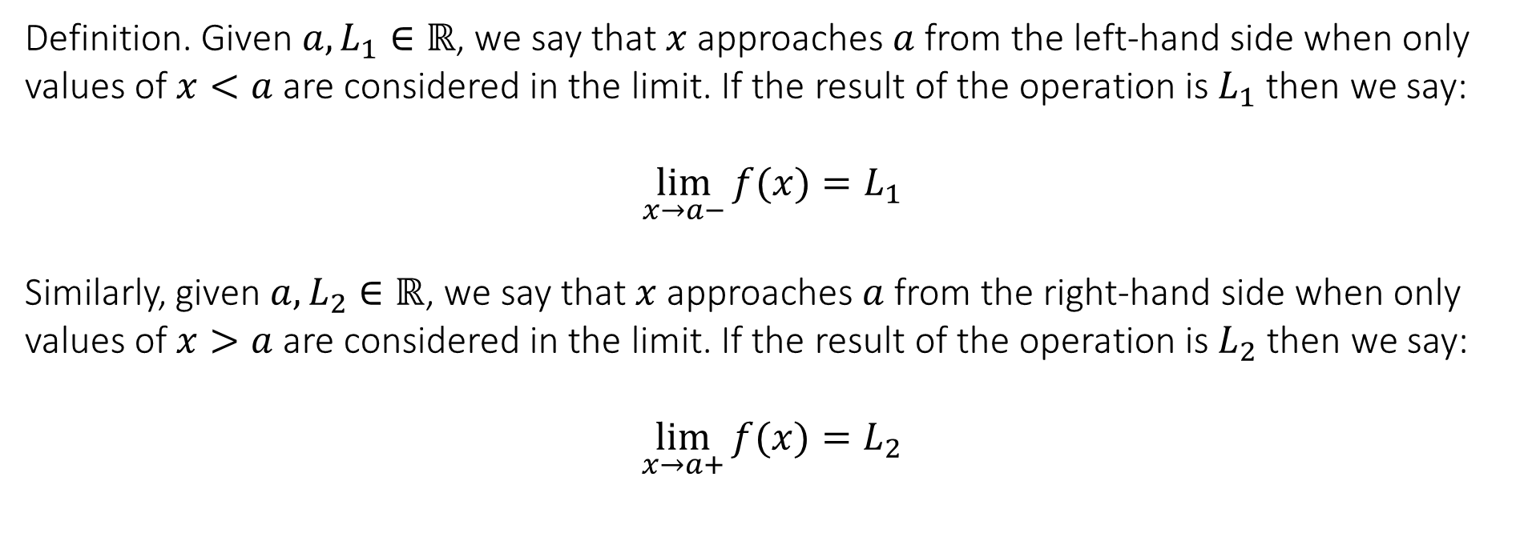
2.1 The concept of limit
One-sided limits: the left and right limit
Definition. Given $a,L_{1}∈ℝ$, we say that $x$ approaches $a$ from the left-hand side when only values of $x<a$ are considered in the limit. If the result of the operation is $L_{1}$then we say:
$$\lim_{x→a−}{f(x)}=L_{1}$$
Similarly, given $a,L_{2}∈ℝ$, we say that $x$ approaches $a$ from the right-hand side when only values of $x>a$ are considered in the limit. If the result of the operation is $L_{2}$then we say:
$$\lim_{x→a+}{f(x)}=L_{2}$$

Slide 28
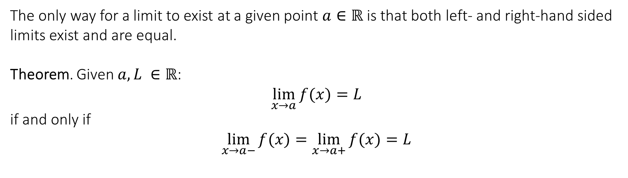
2.1 The concept of limit
One-sided limits: the left and right limit
The only way for a limit to exist at a given point $a∈ℝ$ is that both left- and right-hand sided limits exist and are equal.
Theorem. Given $a,L ∈ℝ$:
$$\lim_{x→a}{f(x)}=L$$
if and only if
$$\lim_{x→a−}{f(x)}=\lim_{x→a+}{f(x)}=L$$

Slide 29
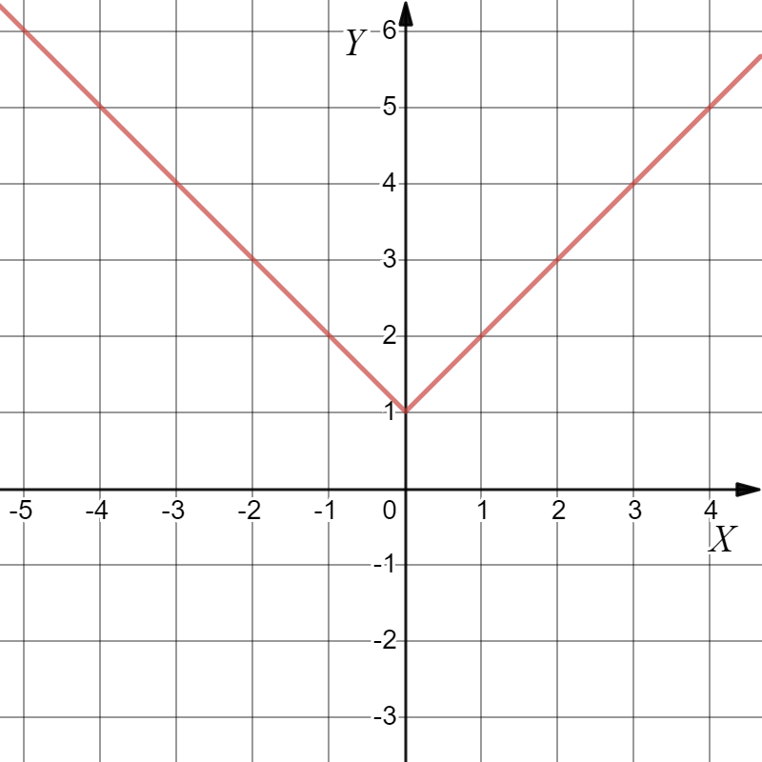
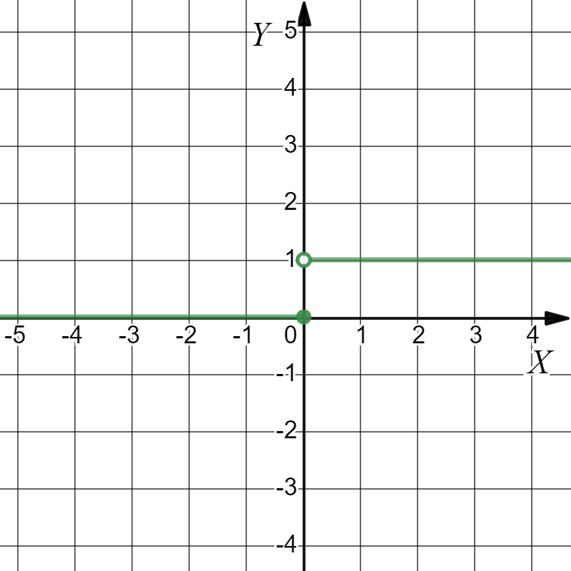
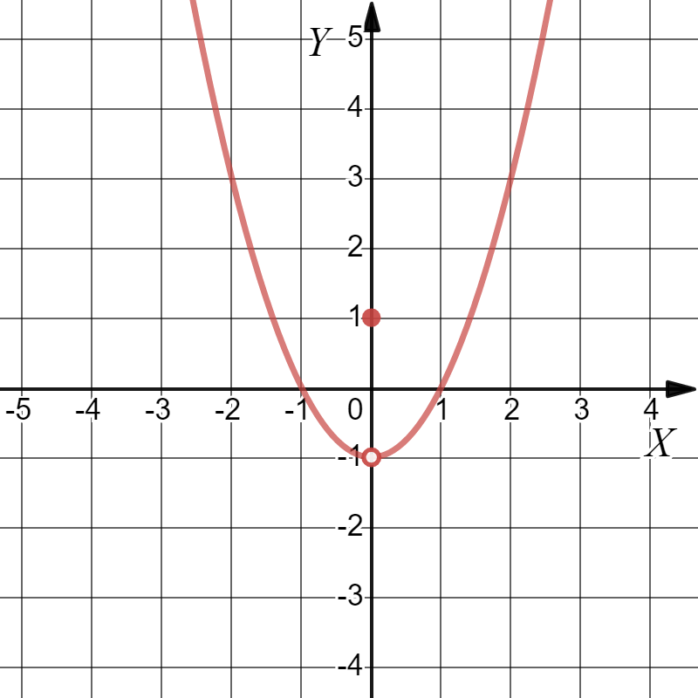







Test your knowledge
Looking at the following graphs of functions, determine the limit at $x$.
$$\lim_{x→3}{f(x)}$$
$$\lim_{x→0}{f(x)}$$
$$\lim_{x→−3}{f(x)}$$
$$\lim_{x→0}{f(x)}$$
$$\lim_{x→2}{f(x)}$$
$$\lim_{x→0}{f(x)}$$
$$f(0)$$

Slide 30
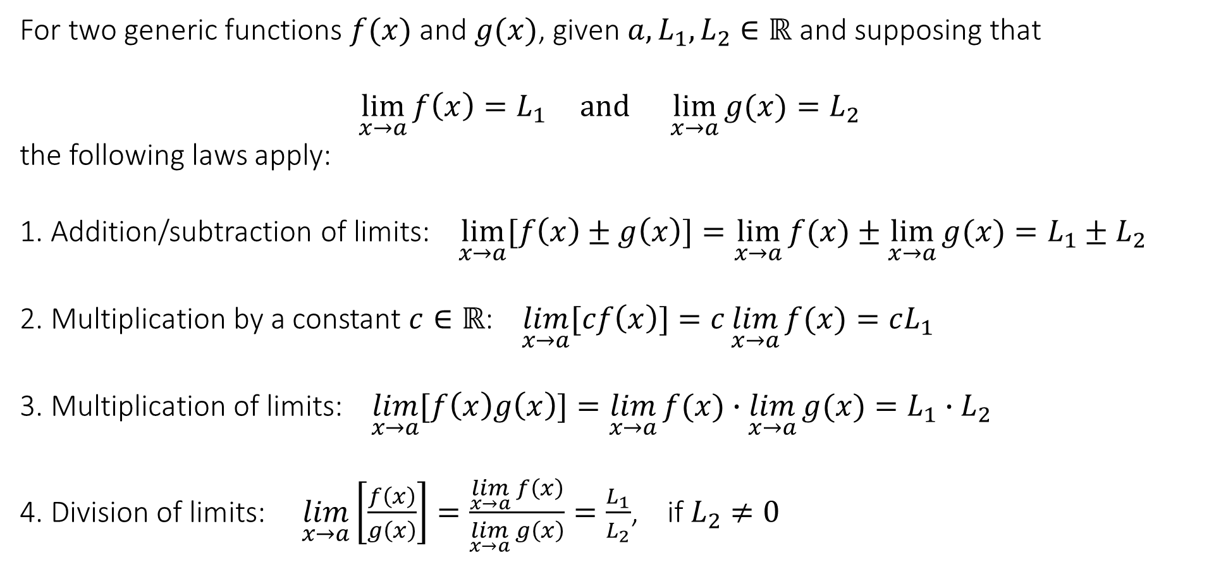
2.2 Limit laws
For two generic functions $f(x)$ and $g(x)$, given $a,L_{1},L_{2}∈ℝ$ and supposing that
$$\lim_{x→a}{f\left(x\right)=L_{1}} and \lim_{x→a}{g(x)}=L_{2}$$
the following laws apply:
1. Addition/subtraction of limits: $\lim_{x→a}{[f\left(x\right)±g\left(x\right)]}=\lim_{x→a}{f(x)}±$ $\lim_{x→a}{g(x)}=L_{1}±L_{2}$
2. Multiplication by a constant $c∈ℝ$: $\lim_{x→a}{[cf\left(x\right)]}=c\lim_{x→a}{f(x)}=cL_{1}$
3. Multiplication of limits: $\lim_{x→a}{[f\left(x\right)g\left(x\right)]}=\lim_{x→a}{f(x)}∙\lim_{x→a}{g(x)}=L_{1}∙L_{2}$
4. Division of limits: $\lim_{x→a}\left[\frac{f\left(x\right)}{g\left(x\right)}\right]=\frac{\lim_{x→a}{f\left(x\right)}}{\lim_{x→a}{g\left(x\right)}}=\frac{L_{1}}{L_{2}}$, if $L_{2}≠0$

Slide 31
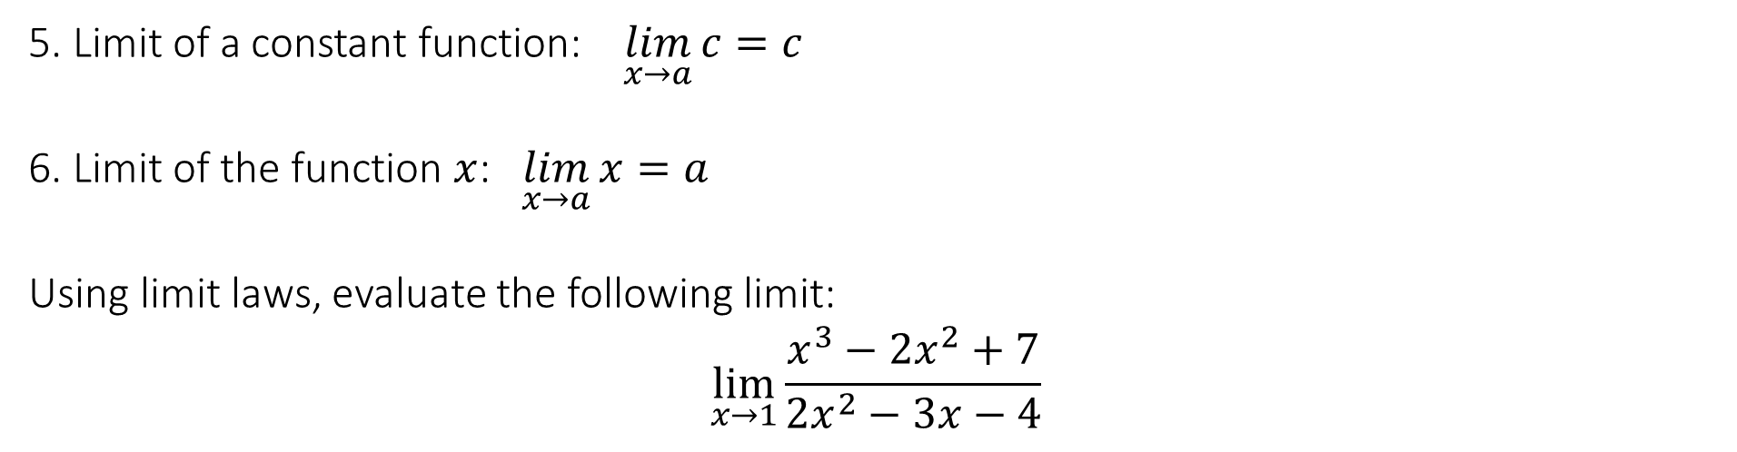
2.2 Limit laws
5. Limit of a constant function: $\lim_{x→a}{c}=c$
6. Limit of the function $x$: $\lim_{x→a}{x}=a$
Using limit laws, evaluate the following limit:
$$\lim_{x→1}{\frac{x^{3}−2x^{2}+7}{2x^{2}−3x−4}}$$

Slide 32
End of Lecture

